Slide 1
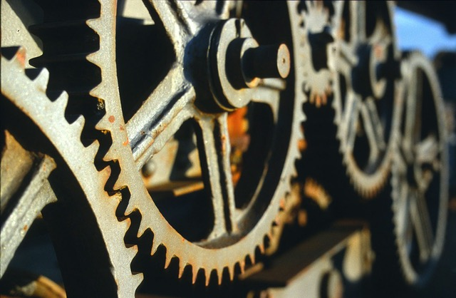
Notes:
Aim is just to introduce them to the lab staff and get them comfortable talking in the space
Why are they here? What brought them here?
What is digital humanities for each of us? What was our own particular path into it
welcome to ask me or us questions as we go
TODO: Look with an eye to the summer retrospective stuff

Slide 2
Land Acknowledgement
We acknowledge the Monacan People, who are the traditional custodians of the land in and around Charlottesville on which we work and live. We pay respect to their elders past, present, and emerging.
We acknowledge the labor and the individual lives of the enslaved Black people who built and sustained the everyday life of the University of Virginia.
Notes:
Much of the ten hours is going to be taken up with

Slide 3
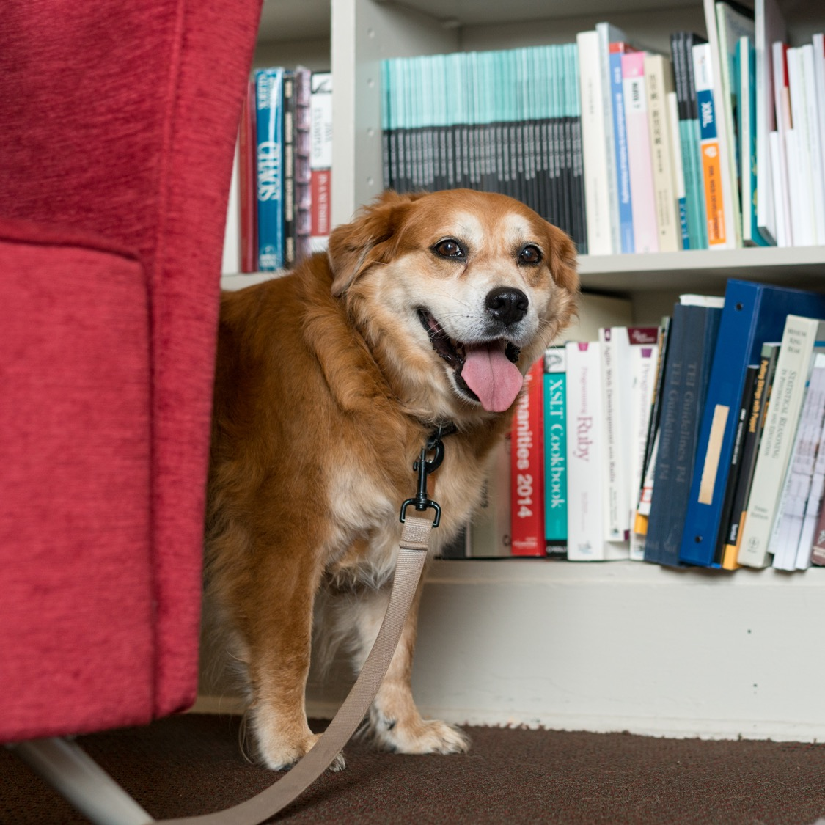
Introductions
Preferred Name
Pronouns
Department / what you do
Something else about you

Slide 4
Spaces and Expectations
We'll be in Shannon 308 for the fall. Hybrid option available only as needed.
Make sure you have good Slack notifications set and engage in that space.
Up to date info here - praxis.scholarslab.org/curriculum/
Mostly set, but things get shifted around
If something is TBD but you need to know reach out early
10 hours a week / 4 hours in session together
Wednesdays and Thursdays from 2-4.
Please be on time
Note on working together
Accountable to each other
First and foremost, kindness and generosity
Notes:
Much of the ten hours is going to be taken up with

Slide 5
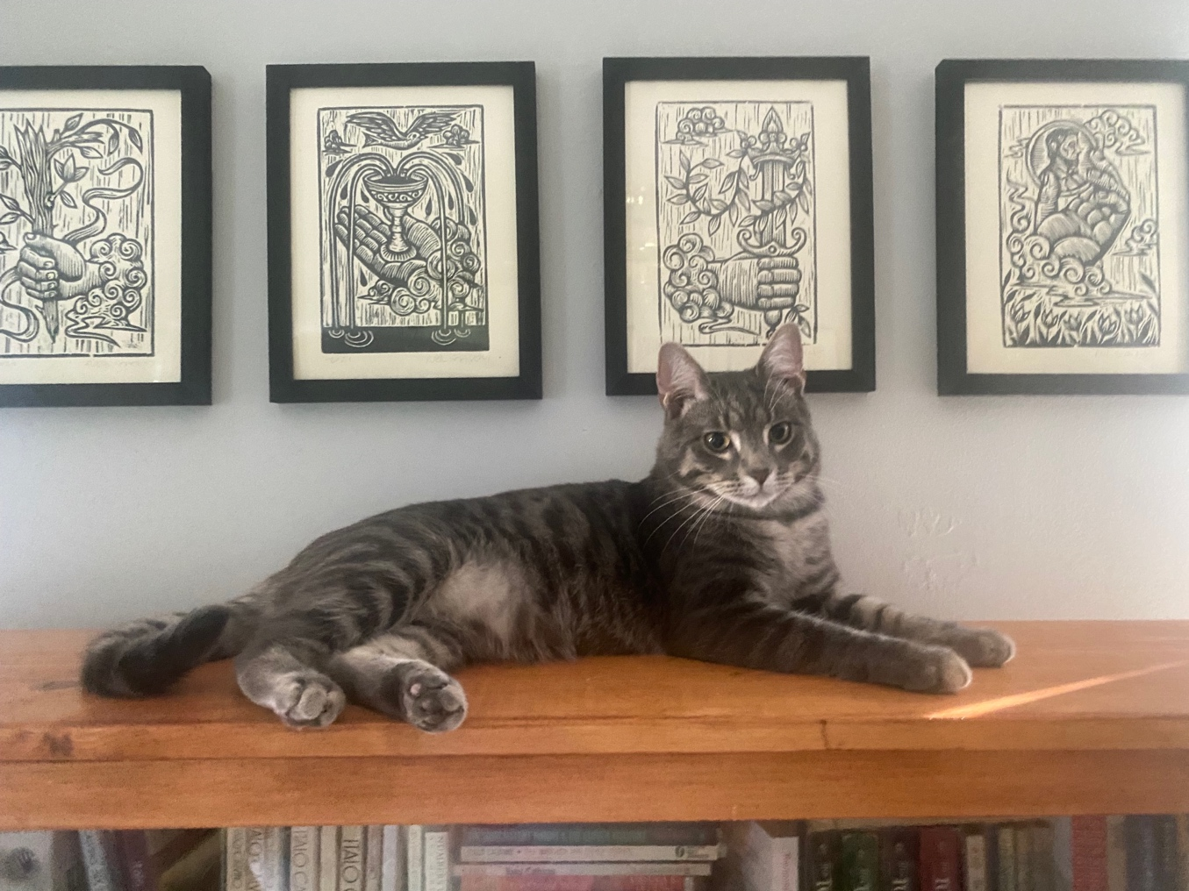
Care Policy
The world is a mess – take care of yourself, yours, and each other.
Absences are OK, but let the group know.
We’re accountable to each other, though, and it’s important to show up, in every sense.
That means a commitment to
Presence, timeliness, accountability
We will address things if presence becomes a
problem, but lead with care and kindness first.

Slide 6
Asking for Help
Work with each other
Work with staff
We have a team-oriented approach, and we hope you will as well
Means we might have to shuffle who will help you if you reach out
Agendas help make sure you get the help you need
That is all to say – when reaching out please let us know what you need help on. That will ensure that we get the right person in the room.

Slide 7
Financial Logistics
If you get paid, let us know
If you think you should get paid but haven't, let us know
If you so much as sense an ill wind about finances, let us know
Better to be redundant than to be delayed
A note on the GSAS portions of your fellowship
Let us know privately after session?
Notes:
We don't hear when things go wrong. We also don't hear when they go right. Let us know about everything.

Slide 8
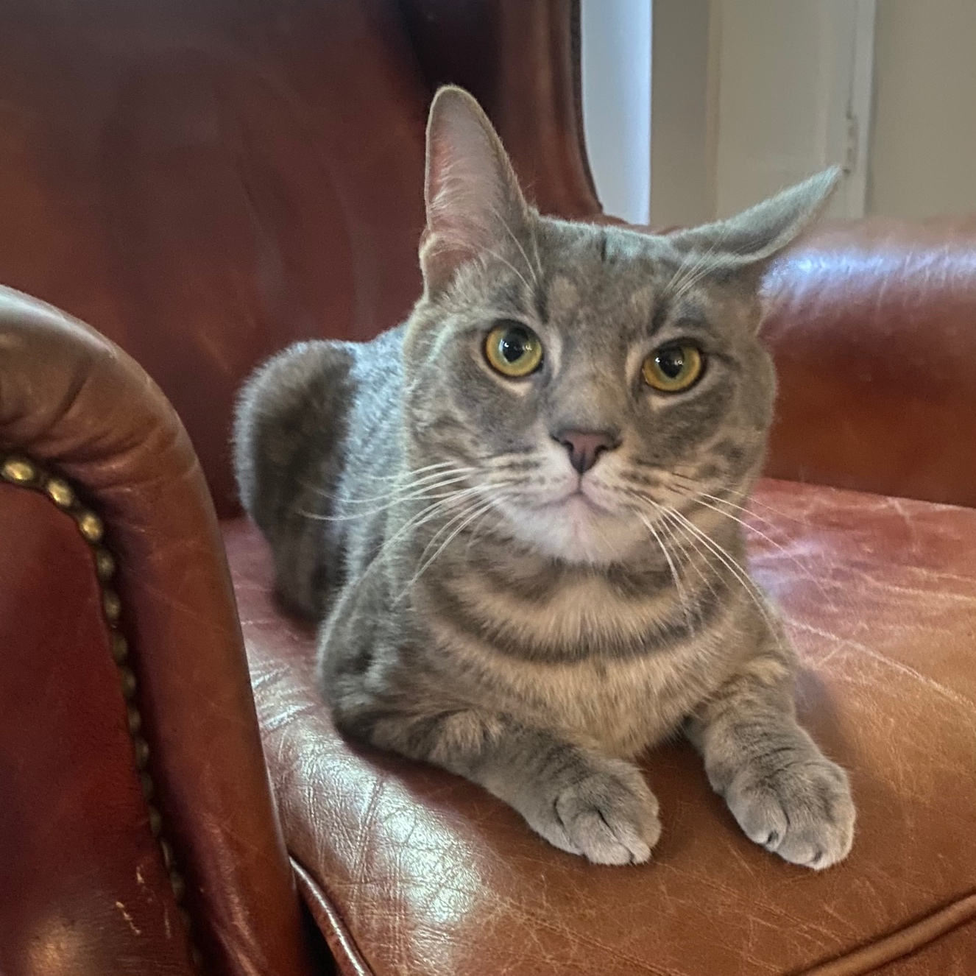
phdplus.virginia.edu
Notes:
Explain program and pass out handbills

Slide 9
Other Scheduling Things
Be thinking about ways to maintain a community
August 30th 2-4; Kardinal Hall
DH Fellow colloquium
TBD; Loren Lee
Cohort-specific meetups
Will let you know about other relevant events and put them on the curriculum page
Come to our events. Let us know if you have ideas!
Notes:
We don't hear when things go wrong. We also don't hear when they go right. Let us know about everything.

Slide 10
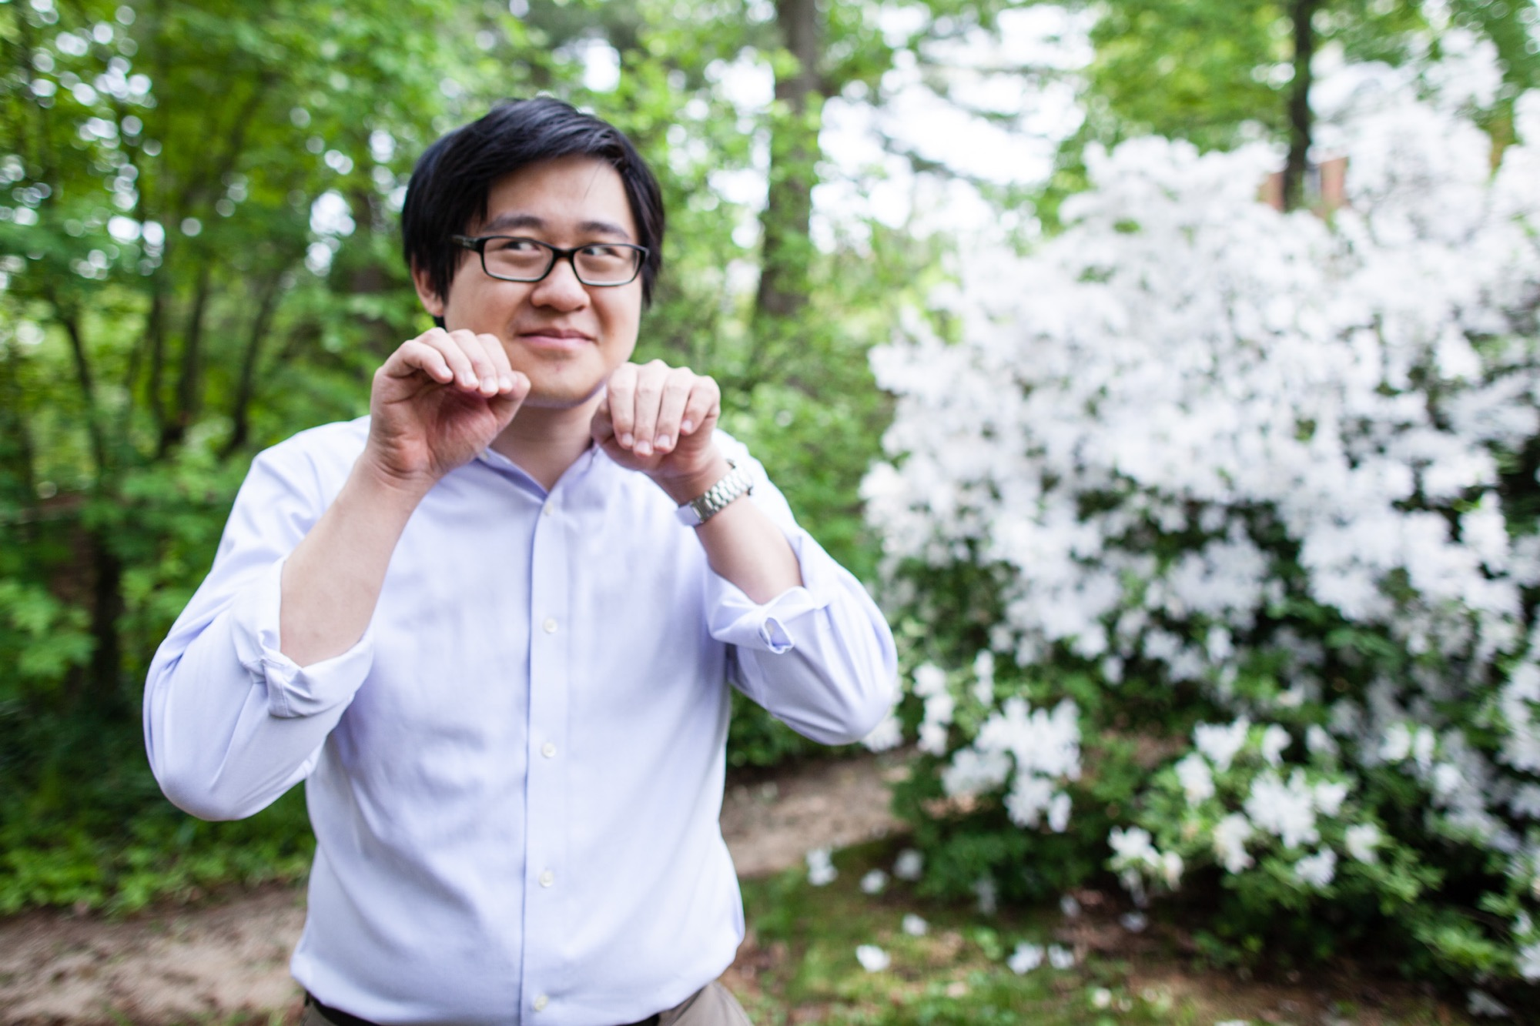
The World According to Shane (Head Shots)
Shane is our awesome photographer
He can do headshots for you
Share one if you already have one.

Slide 11
Blogging and Writing
Expected to blog semi-regularly
Two scheduled on the calendar; feel free to do more.
For most of you, this will be unpleasant. That's ok!
A blog post can be anything you want it to be!
Check scholarslab.org for ideas
bit.ly/Slab-Blog-Docs
Start drafting now, and note deadlines on the curriculum page. Ask for help if you need it.
Caveat about the internet/cesspool
Talk to Brandon if interested in more formal publishing

Slide 12
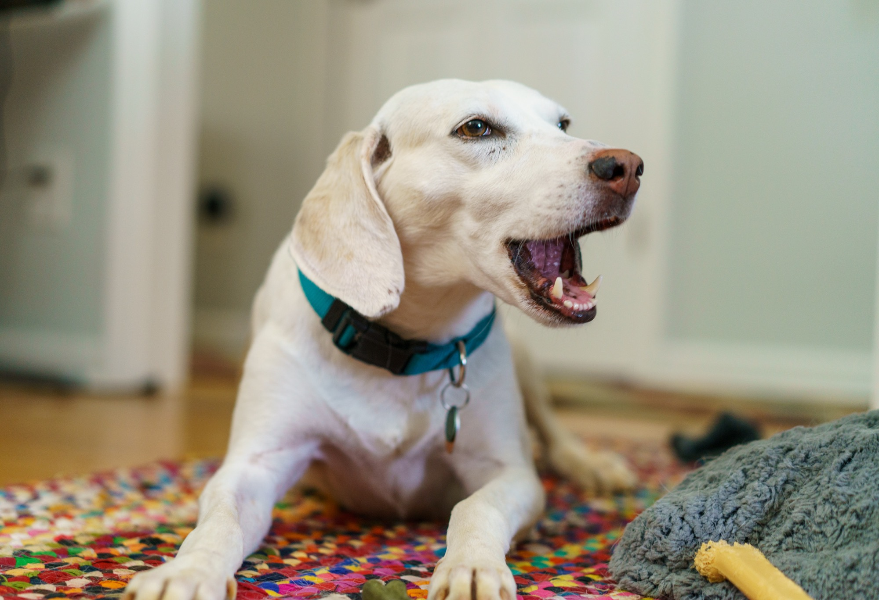

Slide 13
Slack and Social Media
All invited to the Scholars' Lab slack
Feel free to make your own channels, but also good to be public
Anything we post you're welcome to chime in on
DH Slack - tinyurl.com/Dhslack
A note about Blue Sky

Slide 14
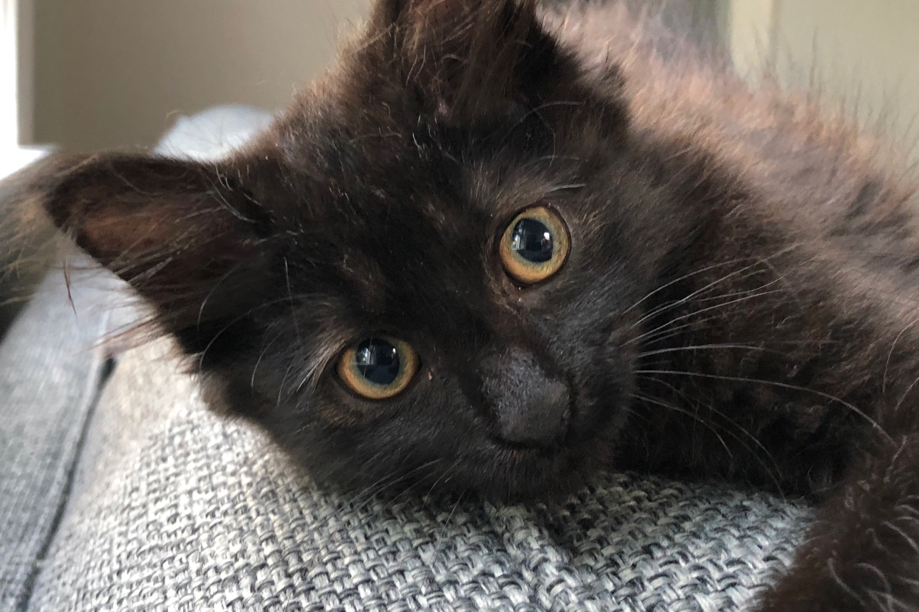

Slide 15
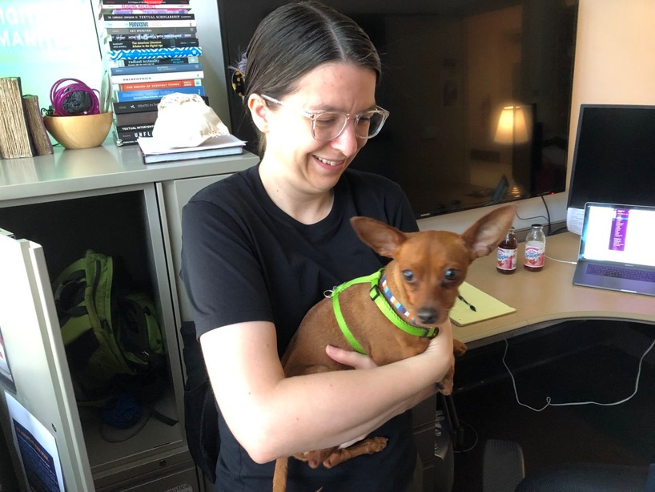
PraxisGeneral, TechLab
Parallel general DH and technical training tracks
Not to separate hacking from yacking, but to make sure both get time
Once each per week
Allows us to go further
More in following slides!

Slide 16
Model for the Year
Portfolio of Project-based Learning Activities
A series of outcomes that reflect the breadth of DH work
Some group activities, some individual
Fall
Communities of DH – group charter; personal plan for the year
Teaching and Learning and DH – DH workshop and teaching statement
Fundamentals and Design Lab – Technical practice
Spring
Research / Infrastructure and DH – event planning; project proposal workshopping
Code Lab – Technical Practice
Hackathon – Light, speculative prototype of a team idea

Slide 17
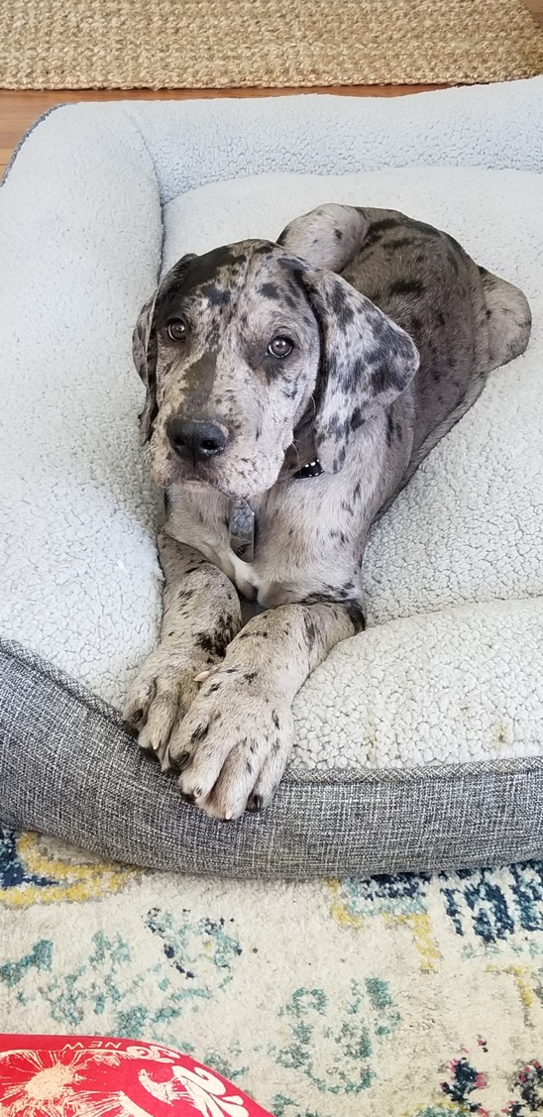
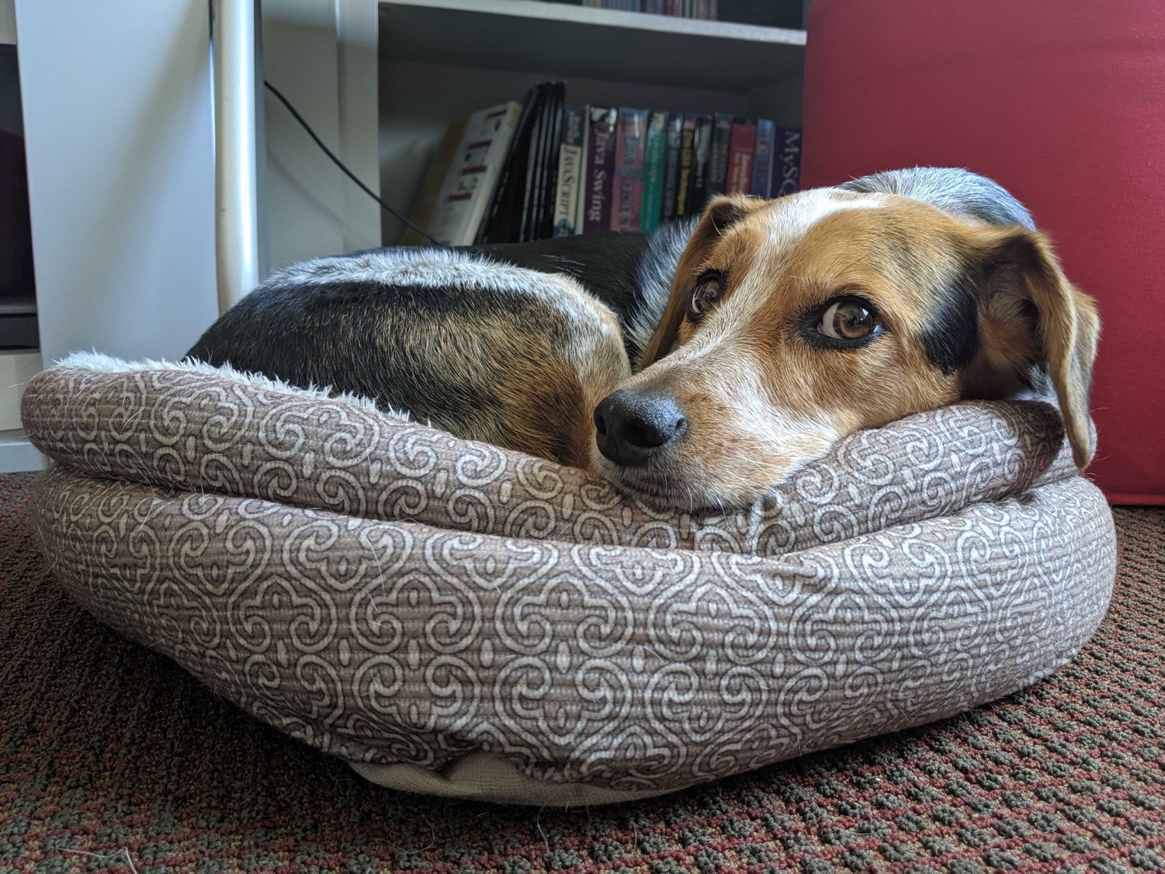

Slide 18
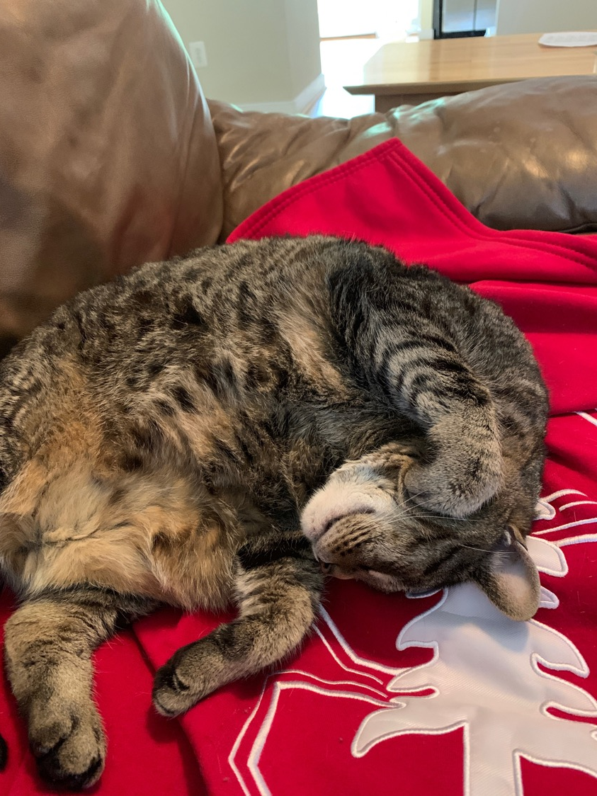
Fall pt. 1 DH Communities – Charter
What constitutes a community in DH? How will we design one together? How do DHers articulate these practices in public?
You will propose a personal plan for the year
Next few weeks! First on September 11
Group will design a charter
Group-authored statement
Values
Goals
Feelings
Ronda will share more
Due September October 2nd

Slide 19
Fall pt. 2 - Pedagogy DH Workshop and Teaching Statement
What does teaching and learning look like in Digital Humanities? What are our own pedagogies, and how can we inflect those in DH?
Two assignments
Lightweight workshops, piloted together
Teaching to learn
Opportunities to share them
Teaching statements with a DH focus
Due December 4th as a blog post

Slide 20
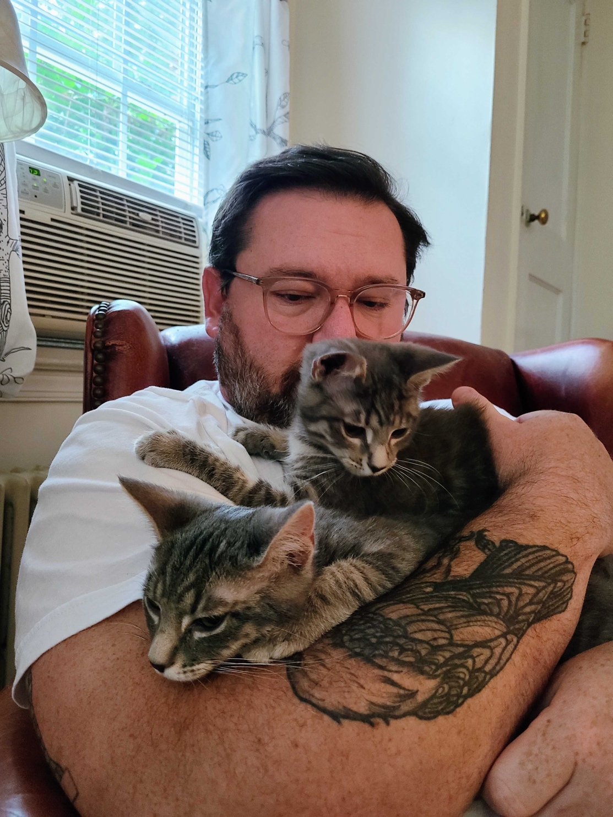
TechFall – Fundamentals & Design Lab
Fundamentals for four weeks
DesignLab is a 10-week primer on critical approaches to design for Digital Humanities work that includes conceptual and application work in the following areas:
HTML, CSS, JavaScript;
Information architecture/organization
Graphic/Visual design elements and concepts
Accessibility + Usability
Scoping/Strategizing approaches for design projects;
Mic to Jeremy and Shane

Slide 21
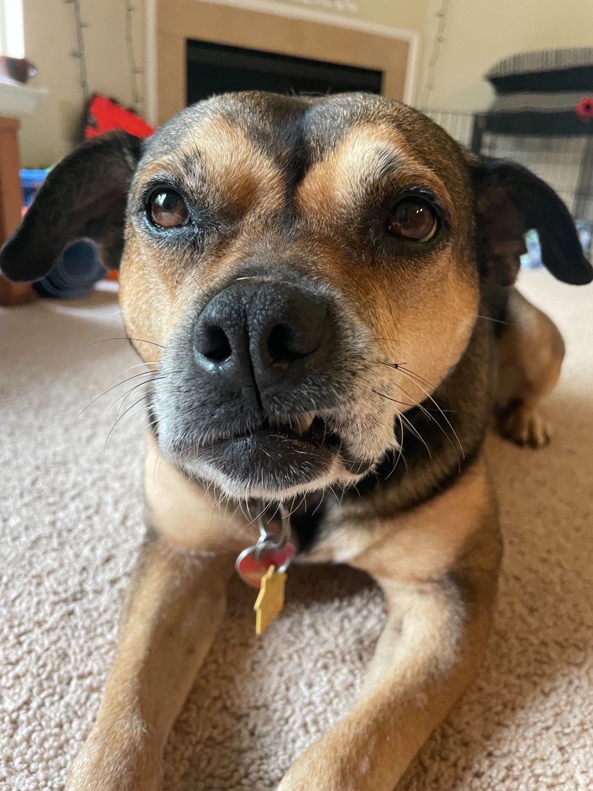
Spring pt. 1 – DH Research / Infrastructure
What do we mean when we call something a digital project, and how do we define them with an ethos that is meaningful to us? How do infrastructure and administration in the field intersect with DH research, enabling or inhibiting it?
Event planning and project design
Personal project proposals for next steps

Slide 22
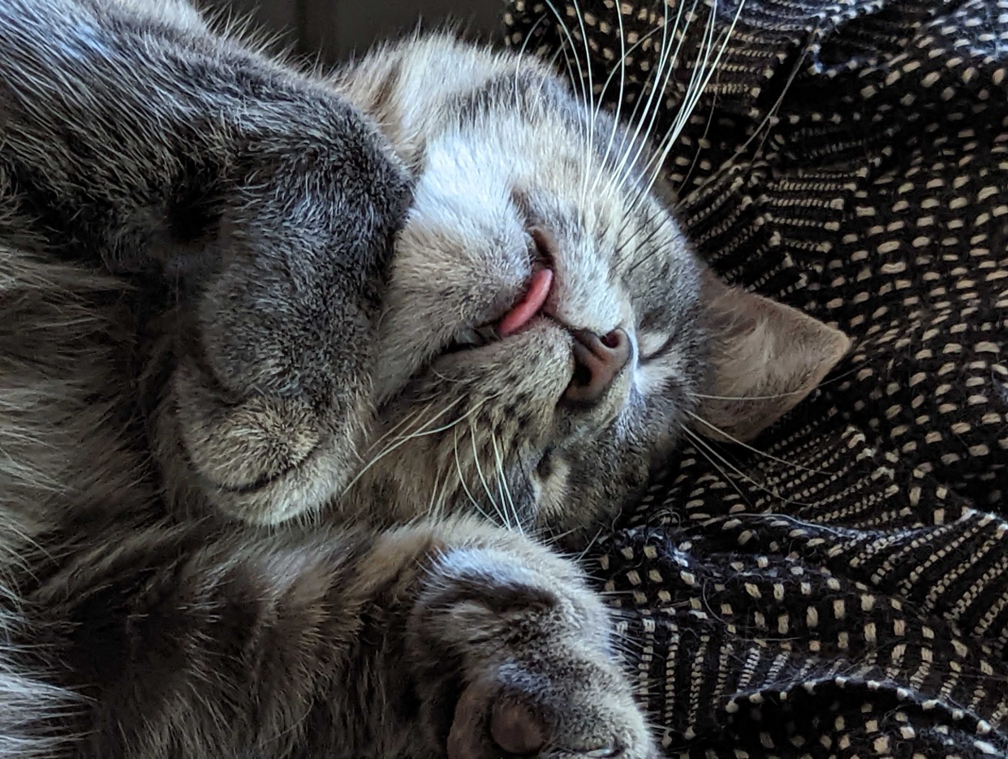
Spring pt 2 – Code Lab
CodeLab is a semester-long introduction to the foundations programming and computational thinking for Digital Humanities.
You will gain experience using a variety of technologies (Python, git/github) relevant to technical work in DH and exercise these new skills with some focused activities relevant to DH work.
Variety of outcomes throughout the semester
Mic to Shane

Slide 23
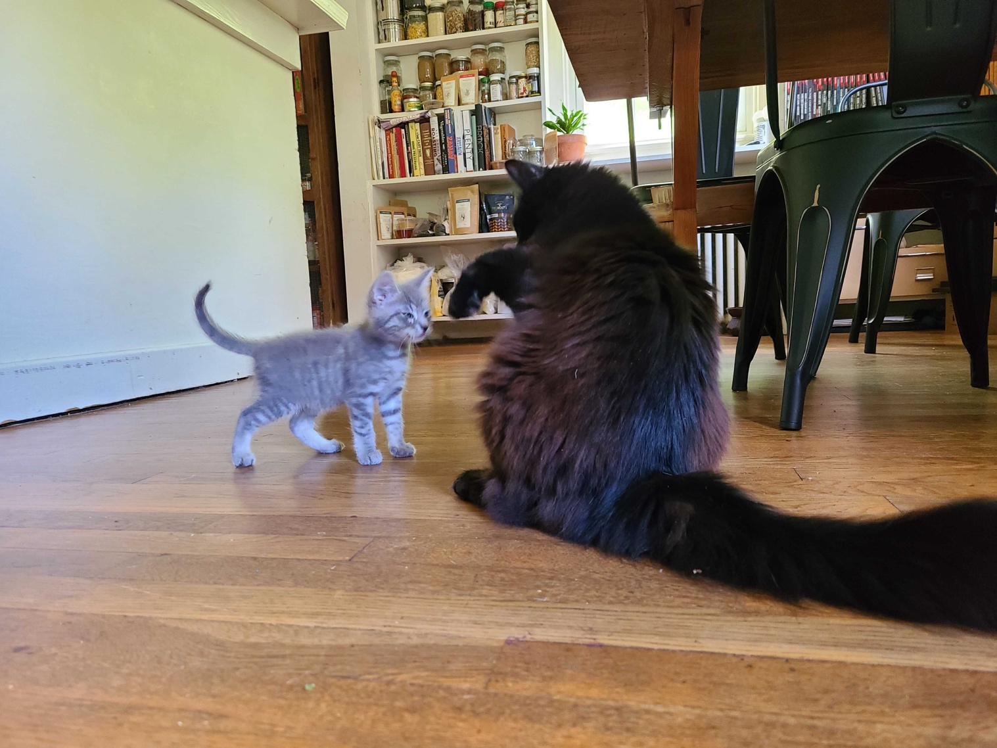
Spring pt. 3 – Hackathon
Putting it all together. What does concentrated team work on a technical project in DH look like? How do we apply our lessons, community, learning, and project design to a technical problem?
A series of intermittent deadlines on the
calendar before then to prepare.
Goal is to produce a poster of your work
Mic to Shane

Slide 25
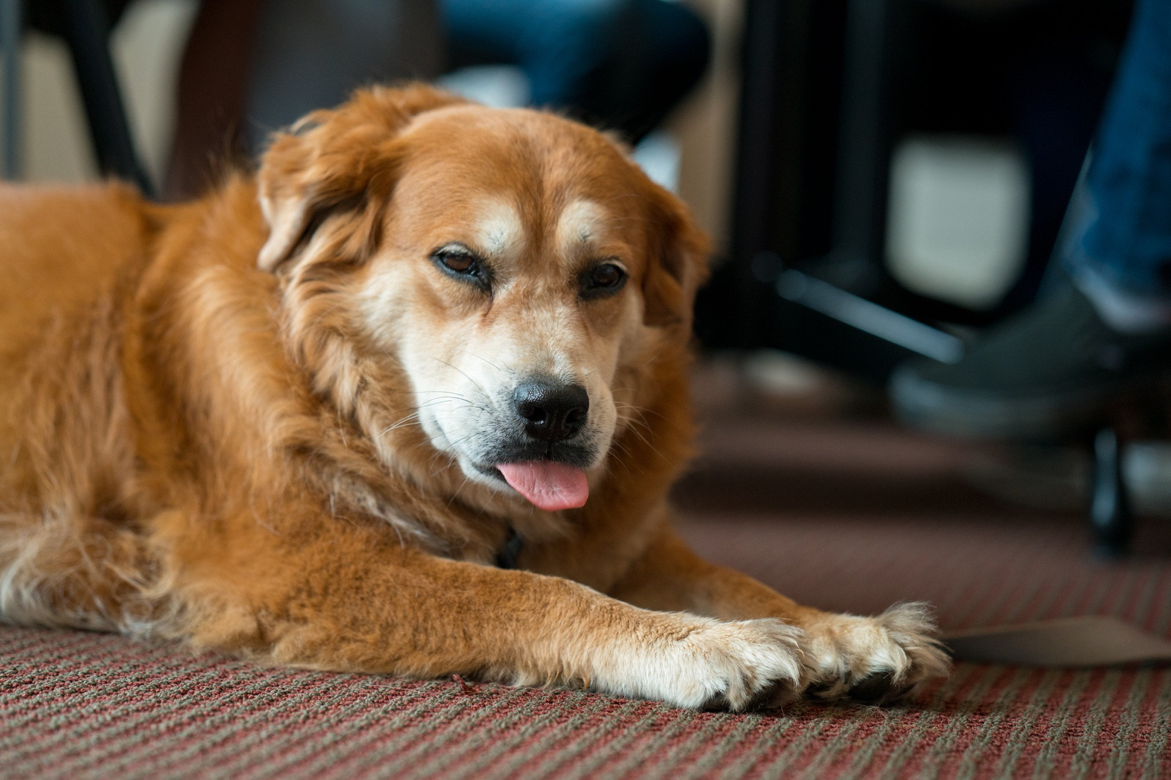

Slide 26

Initial Things pt 1
Meet with Shane 1:1 for tech set up
Talk to Brandon if you are interested in publishing
Readings, etc. on the curriculum page
Be present
Check in about finances

Slide 27
Initial Things pt 2
Upcoming design jam student interest sessions
come prepared to talk about your research interests for 10-15 minutes (if you have DH areas that interest you that’s great but the point will be to guide you towards things to follow up on throughout the year) and your plan for learning this year
You’re all scheduled out
Start working on your charters together
Note respondents and facilitators on curriculum

Slide 28
Questions and First Discussions
Notes:
Why are you here?
What do you want out of life? Who are you really?
What are some general reactions to the documents I circulated in advance

